Slide 2
Biometric Solution Touch & Pay

Slide 3
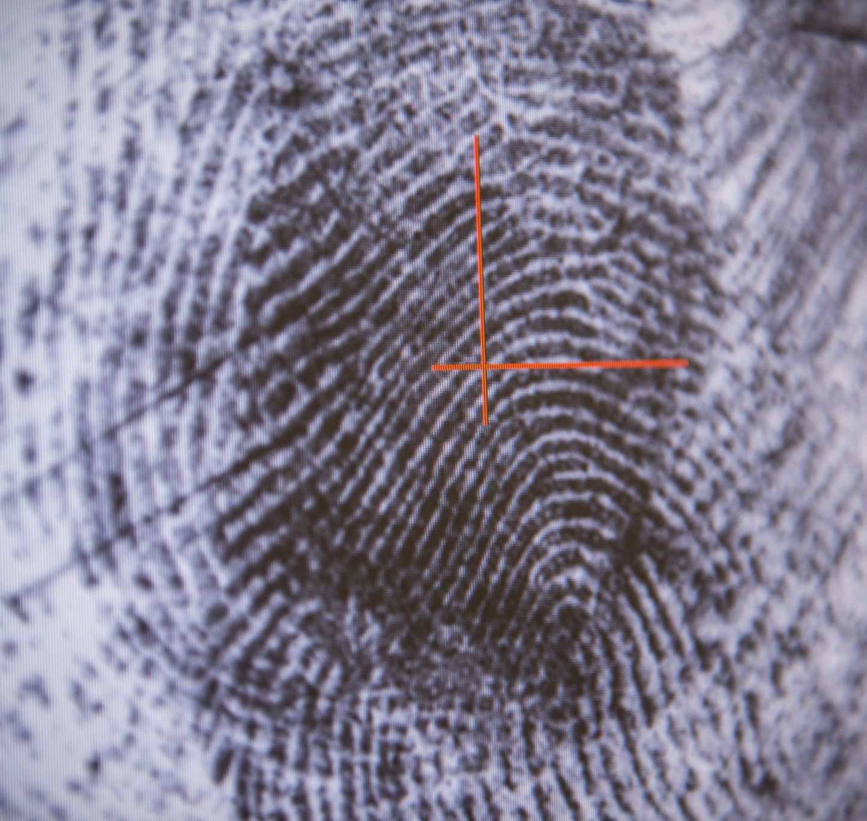
Background
Biometric security is rapidly gaining popularity as a reliable identification system. It measures unique physiological characteristics, such as fingerprints, facial recognition, irises, and voice patterns, to ensure accurate and secure authentication.
This innovative approach eliminates the need for users to remember abstract strings of values and offers a great substitute for traditional authentication methods. It's amazing to witness how technology keeps evolving and providing better solutions to modern security needs.

Slide 4
Market
According to the study conducted by the Fortune Business Insight (2021), biometric solution market value will continue to grow significantly in the years to come. The global biometric system market size was valued at USD 29.09 billion in 2021 and is expected to reach USD 76.70 billion by 2029, with a CAGR of 13.9% during the forecast period.
The rising adoption of biometric solutions has been recorded in consumer electronics devices, such as smartphones, laptops, tablets, and smartwatches.
Biometric solutions have become increasingly popular in various industries, including: security, healthcare, banking, consumer electronics, and law enforcement. It is changing the way we approach security and authentication, and how it is becoming an essential tool in ensuring accurate and secure identification.

Slide 5
Finger Payment Method
The finger payment method is a great way to pay for things without having to worry about entering a PIN or signing a receipt.
With the biometric payment system, all you need to do is touch the card or device with your finger and the transaction will be authorized.
This method offers:
Convenience to users, as it is quick and easy to use.
It is very secure, as the user's fingerprint is unique and cannot be forged or stolen. The fingerprint data is stored securely in the card or device, so you can rest assured that your personal information is safe.
The verification process is very fast and does not require any additional equipment or network connection.
Overall, the finger payment method is a reliable and efficient way to make payments.

Slide 6
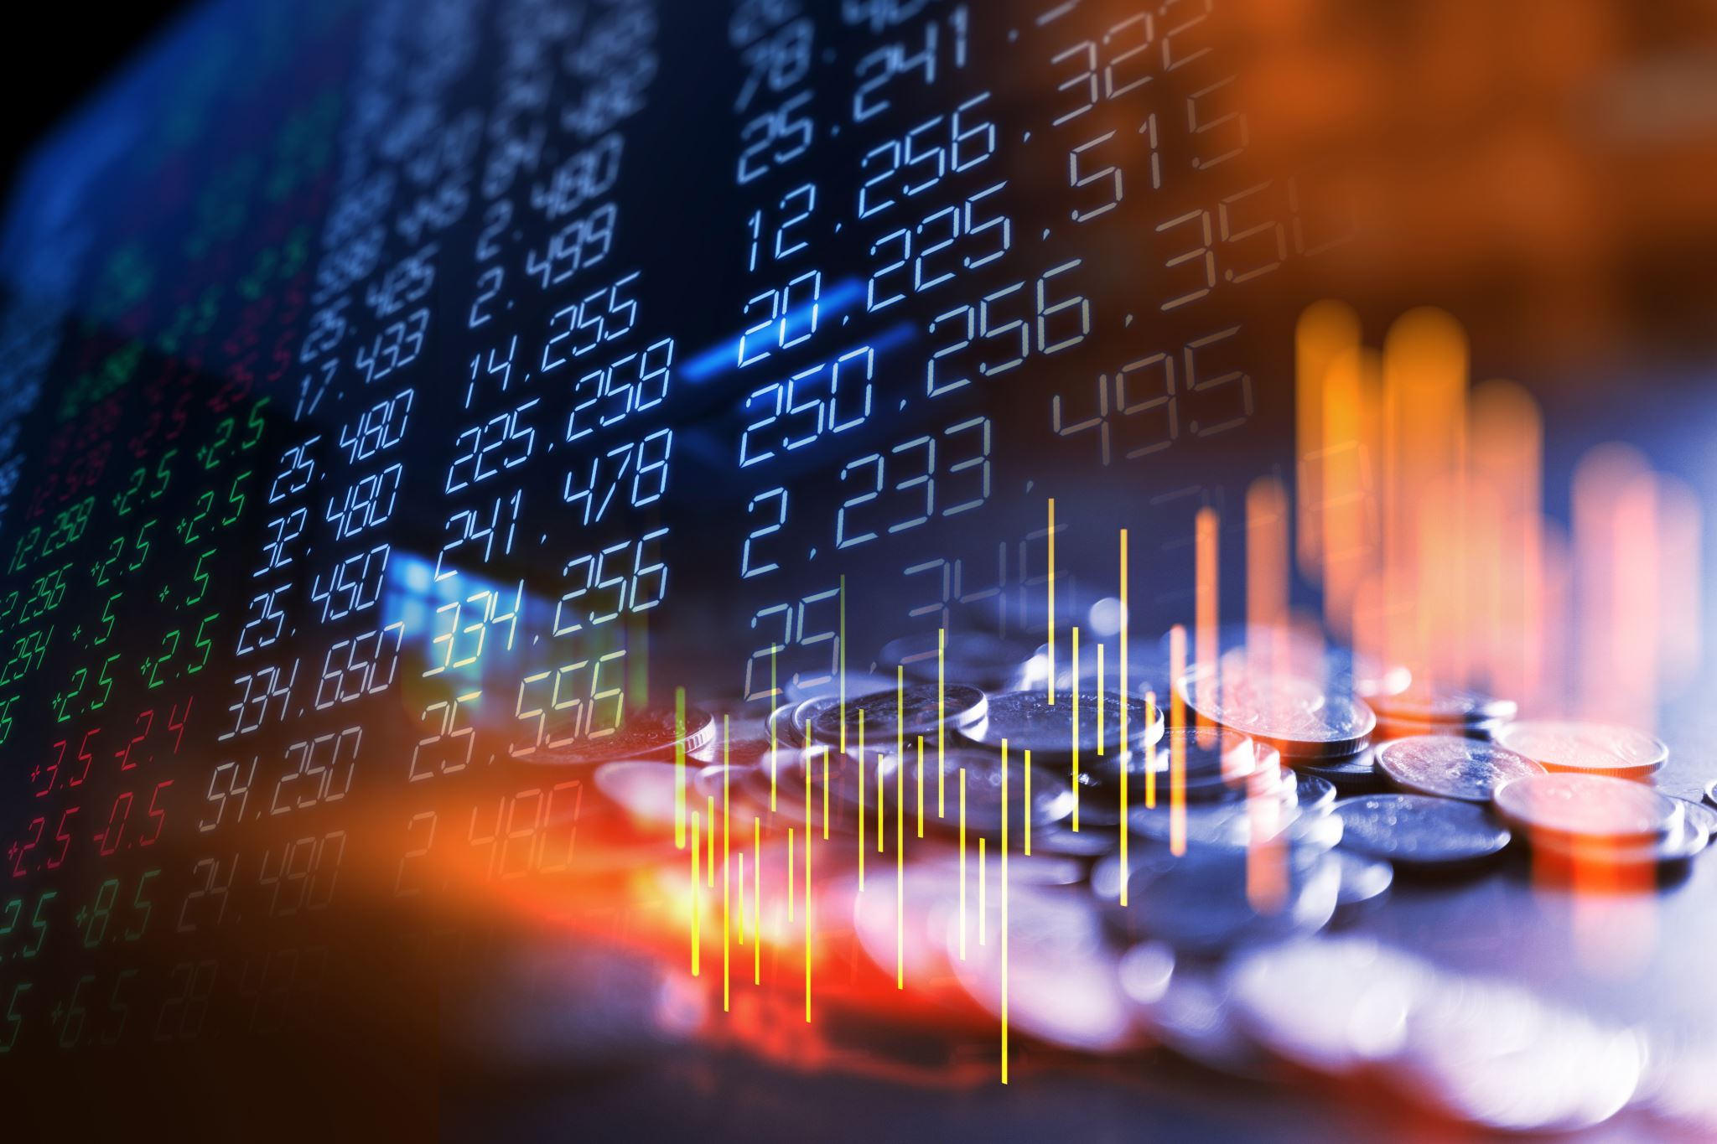
Background
Safety, in the realm of banking and finance, is the wide variety one priority for organizations and their customers. In today’s world of fast
digitalization and hyper-connectivity, making sure the safety of an individual’s assets, economic or otherwise, has become quite an onerous venture due to growing threats of cybercrime. To combat such unwarranted situations, where a customer’s financials and regulatory compliance are at risk, governments and banks all over the world have adopted Know You Customer (KYC) to forestall the occurrence of fraudulent and money laundering activities. What is KYC? KYC means Know Your Customer and sometimes Know Your Client. KYC or KYC check is the mandatory process of identifying and verifying the identity of the client when opening an account and periodically over time. In other words, banks must make sure that their clients are genuinely who they claim to be. Banks may refuse to open an account or halt business relationship if the client fails to meet minimum KYC requirements.

Slide 7
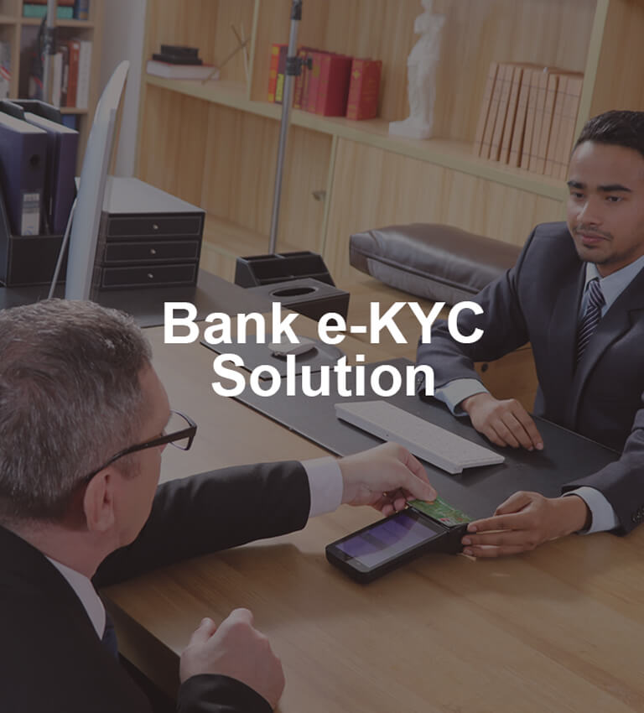
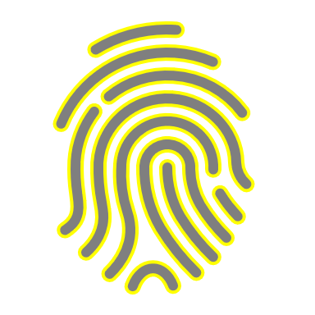
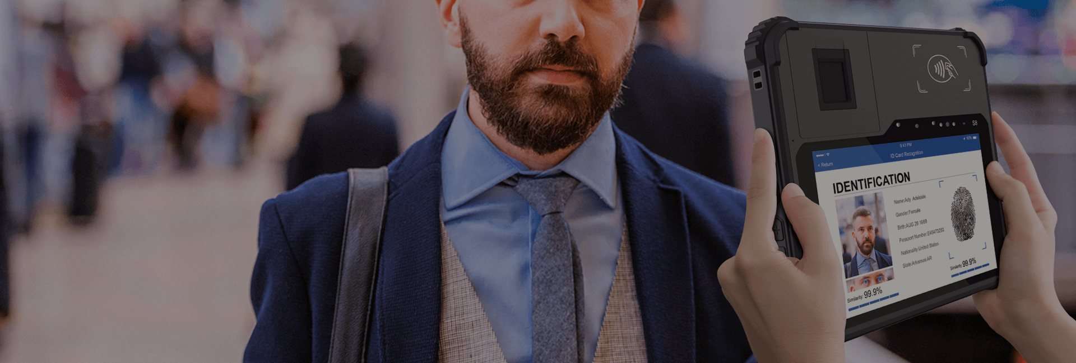
Bank KYC Solution
Create a colorful future

Slide 8
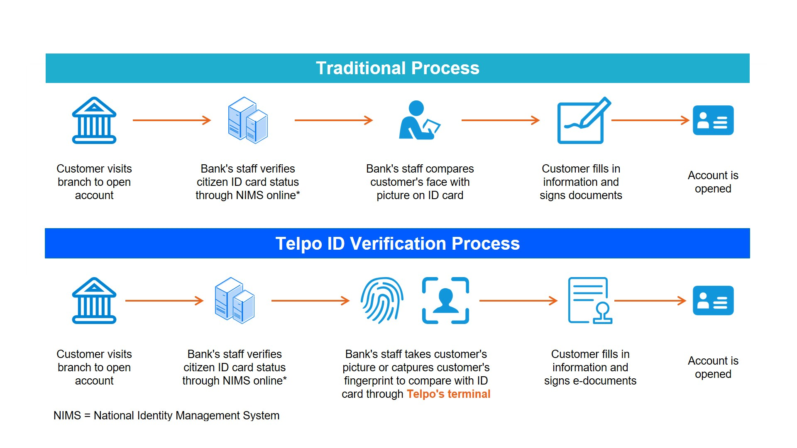

Slide 9
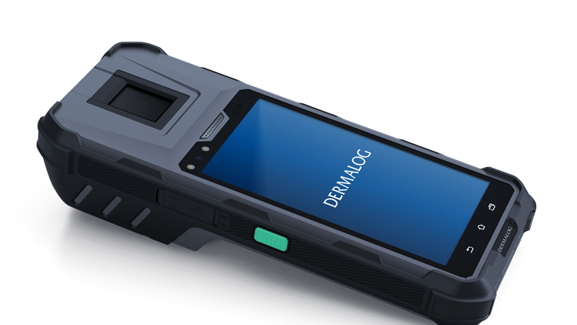
Compared with the traditional verification process, Biroform will offer a biometric terminal to enable bank staff to take a customer's picture or capture his fingerprint to compare with ID card. With unique and specific biometric characteristics, personnel identification will be truly recognized. And the e-document service will certainly ease staff burden on managing and keeping personnel information.
Take Biroform biometric terminal as an example. It adopts
FBI PIV and FBI Mobile ID certified FAP20 optical scanner, which supports multi-dynamic range (MDR) technology, live fingerprint detection (LFD) technology. Importantly, it complies with NIST certified interoperable image & template format standards (ANSI-378, ISO19794-2/4) and image compression standard (WSQ), ensuring collect and record user fingerprint in a fast, safe, and efficient way.
Multiple scanner & card reader modules can be chosen include NFC scanner, smart card reader, secure access module (SAM) card reader, front& back camera, etc. As different countries have various demands on opening an account, it will be better to choose the most suitable configuration.

Slide 11
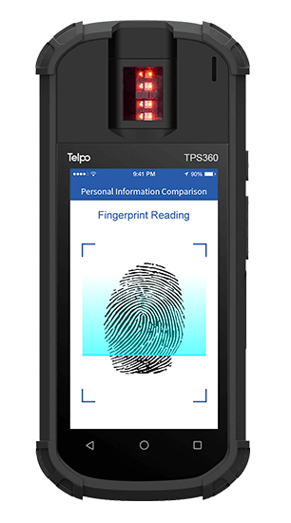
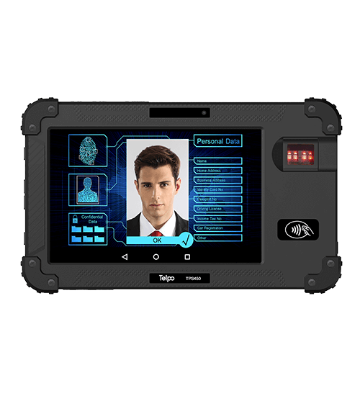
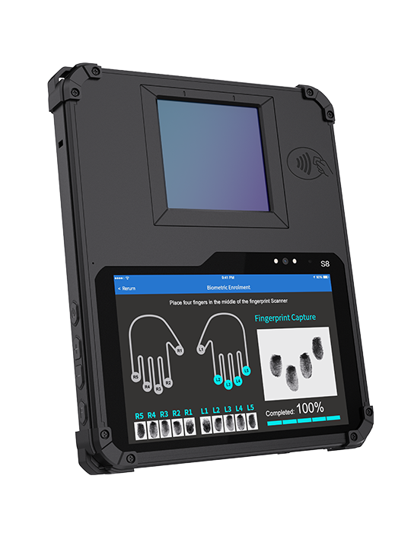
Server-driven matching of - for example fingerprint or face as well as both biometrics in combination leads to a full replacement of PIN numbers and passwords. Mobile payment devices and POS including biometrics are part of BIROFORM solution. BIROFORM “FingerPayment” significantly increases security for both retailer and customer as payment cards and bank notes become dispensable and the payment process is handled by using a fingerprint.
Since the fingerprint is not permanently saved as an actual image, but as an encoded template generated from the acquired image, privacy rights are not infringed. As well, there is no possibility for third parties to steal fingerprint images. The payment process is carried out with high-tech point-of-sale terminals that are easy to use and attractive for customers, thus creating customer retention marketing benefit. Thanks to increased efficiency and a growing customer base BIROFORM “FingerPayment” on average amortizes within just six months after implementation.
Personal Registration – Simple, Fast and Convenient
Fingerprint data, bank details and personal information will be interlinked. Entering the data can be done on a self-service terminal. Customers can now start their shopping.
Reduced Waiting Times at the Checkout
Compared to payment processes using cash or general bank cards (entering and confirming a PIN number) “FingerPayment” significantly saves time. BIROFORM Fingerprint Scanners and corresponding AFIS software provide efficiency for customers and stores.
Complete Security
Data security is ensured. Processes are not accessible for third parties. Stored datasets are only visible for authorized individuals.

Slide 12
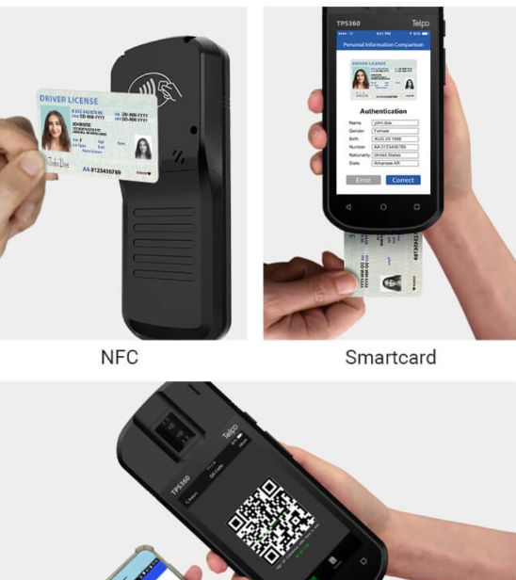
Live Finger Detection(LFD) Technology
Distinguishes fake fingerprints made from various materials including clay, rubber, silicon, glue, paper, film and more.

Slide 13
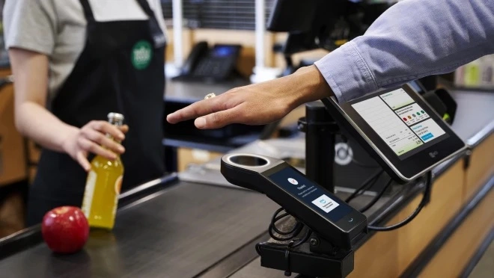
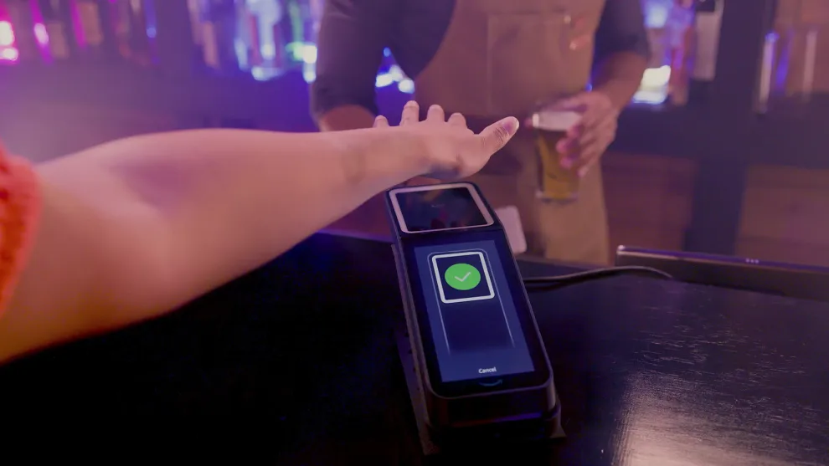
Our COMPETITION WITH AN UNSAFE SYSTEM,
Our Biometrics system is a system that works with 100% security.
On this system, you can use an image that has been certified and not certified by an American institution and a banking institution

Slide 14
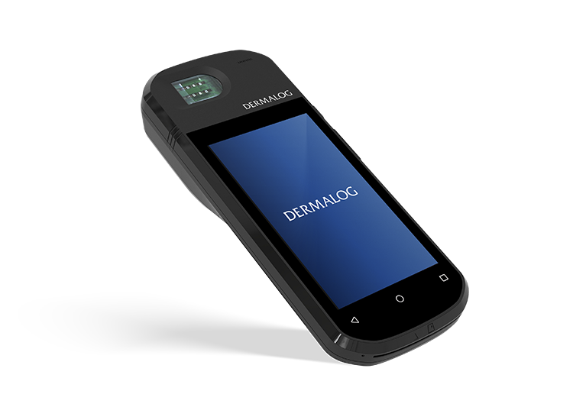
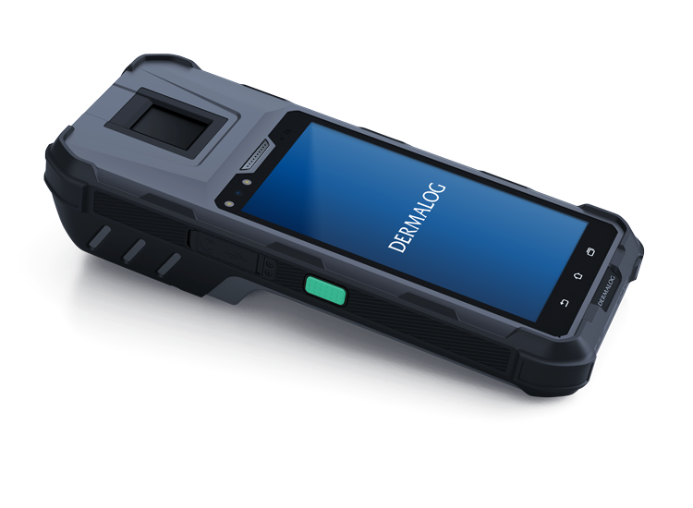
Investment
CAPEX -One time implementation fee
One time SW license fee
OPTIONAL;
- Annual Maintenance and Support
- 8x5 hours per week
- 24x7 hours per week
OPEX -One time Implementation fee,
- Option 1: Revenue share - % from each transaction
OR
- Option 2: Monthly subscription per number of active users
Smart Verification Terminal 4500
Smart Verification Terminal 4000SE

Slide 16
birofinger@usa.com
www.bfinger.us

